Slide 1

WATER QUALITY AND SUPPLY

Slide 2
Definition of terms
Water quality is defined as the physical, chemical and biological characteristics of water. It is a measure of the condition of water relative to the requirements of one or more biotic species and or to any human need or purpose. It is most frequently used by reference to a set of standards against which compliance can be assessed.
Water supply means the provision of appropriate facilities and services for the sourcing, treatment and distribution of potable water. (Water supply and Sanitation Act, 2009) OR is the complete layout of getting water from the source, treating it for removing impurities and then, distributing it to the public for various uses.

Slide 3
Introduction
Vital natural resources which forms basis of life.
is a chemical substance with the chemical formula H₂O
found in 3 states liquid, solid and gases
70% earth surface covered by water and ocean holds 96.5% of all earth’s water
animals and plants have 60-65% water in their body
Water plays an important role in making human life not only survive but comfortable and luxurious
in ancient cities there used to be a network of water supply and its proper disposal.
Notes:
Water is the most essential commodity for the sustainance of life.

Slide 4
Intro cnt........
Water then was carried through earthen and stone pipes and usually untreated.
But now-a-days the importance of treated water is well understood and it is treated (usually) before supplying it to community.
Water now-a-days is conveyed through plastic/PVC pipes which are more durable and do not corrode.

Slide 5
The Public Water Supply in the Roman Empire

Slide 6
The aqueduct (=pipe system) was built to keep the city tidy and to avoid illnesses
Under Augustus’ rule, the whole water supply system was modernized, and numerous public wells and fountains were built.
By the 1st century B.C. the fresh water came into town in a high aqueduct
The water was flowing continously, kept the street clean

Slide 7
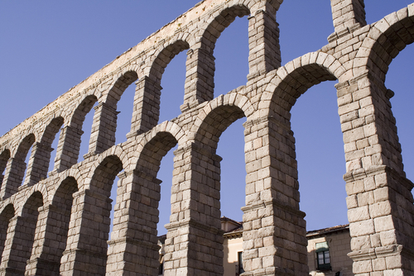
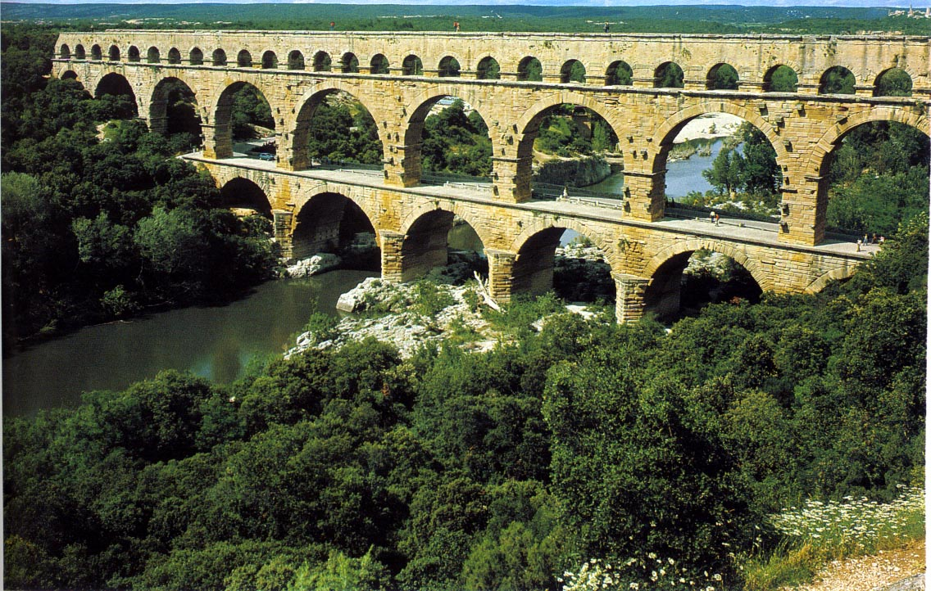
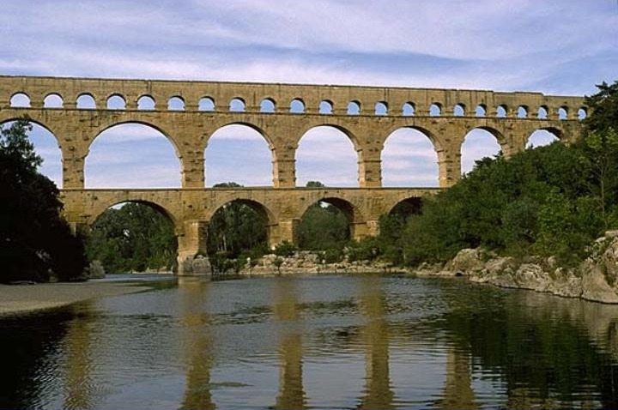
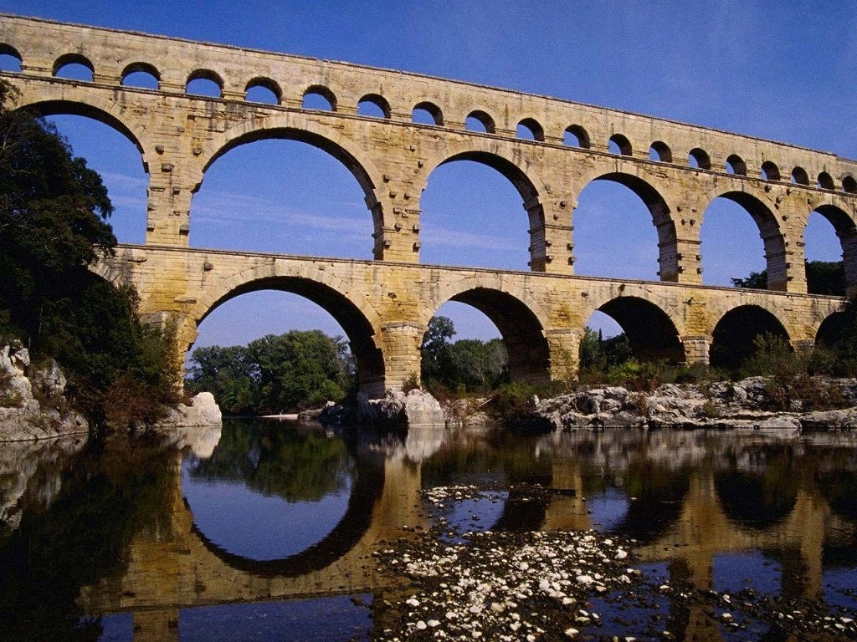

Slide 8
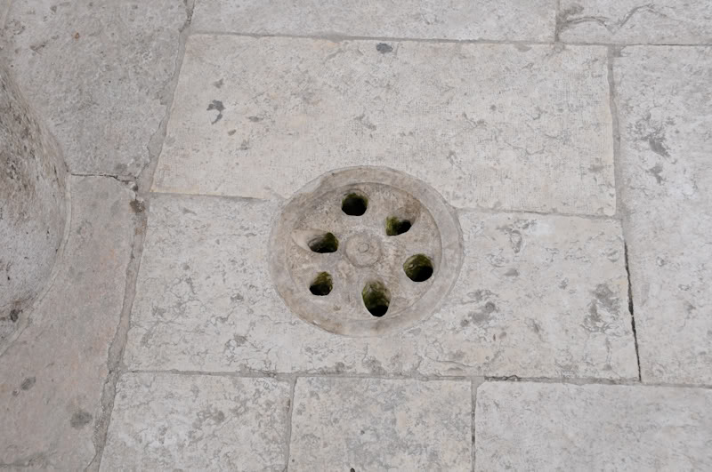
A small ditch in the middle of the stoned streets, so dirty and rainwater were carried away.
These ditches discharged into huge underground drains.

Slide 9
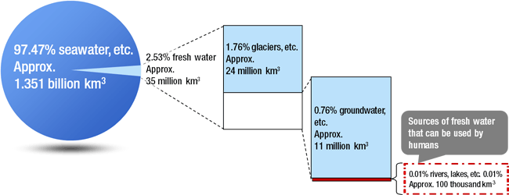
Global Water balance
Amount is finite (how is it possible?)
Uneven distribution
Source: “Water Resources in Japan,” Ministry of Land, Infrastructure, Transport and Tourism

Slide 10
Global water balance cont….
Water keeps on cycling endlessly through environment “Hydrological cycle”
  evaporation or transpiration
  precipitation
  condensation
  runoff

Slide 11
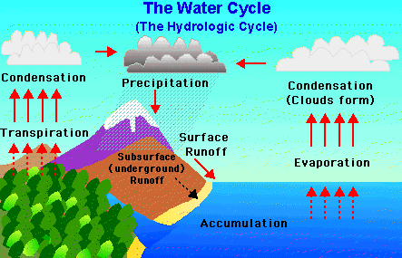

Slide 12
What do you use water for?

Slide 13
Uses of water
Drinking and cooking
Bathing and washing
Street washing
Watering of Lawns and Gardens
Fire extinguishing
Air-conditioning and heating system
Recreational purposes

Slide 14
Uses of water cont…..
Water use in summary can be distinguished into three different types
Withdrawals or Abstractions
Consumptive Water Use
Non-Consumptive Water Use

Slide 15
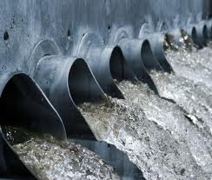
Withdrawals or Abstractions
Where water is taken from a surface or groundwater source
after use returned to a natural water body
e.g. water used for cooling in industrial processes returned to a river
such return flows are important for downstream users

Slide 16
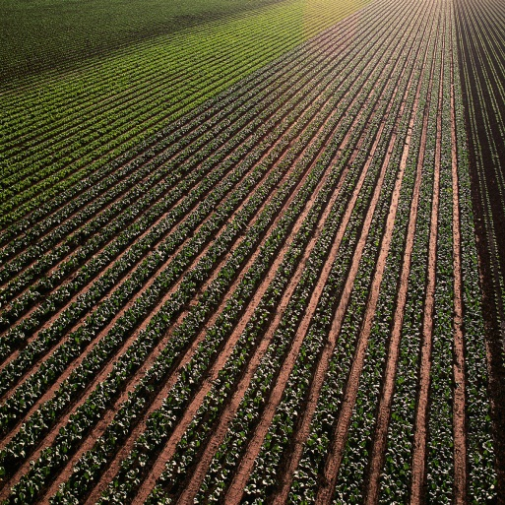
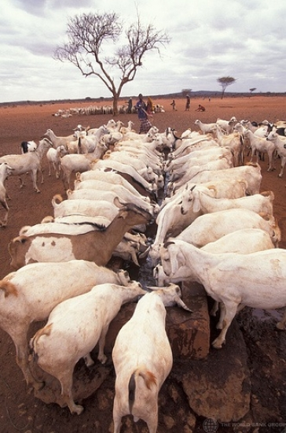
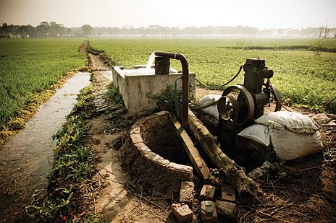
Consumptive Water Use
Water consumption that starts with a withdrawal or an abstraction but in this case without any return flow
water abstracted that is no longer available for use
it has evaporated, transpired, been incorporated into products and crops
consumed by man or livestock or otherwise removed from freshwater resources
e.g. water use include steam escaping into the atmosphere and water contained in final products i.e. it is water that is no longer available directly for subsequent uses

Slide 17
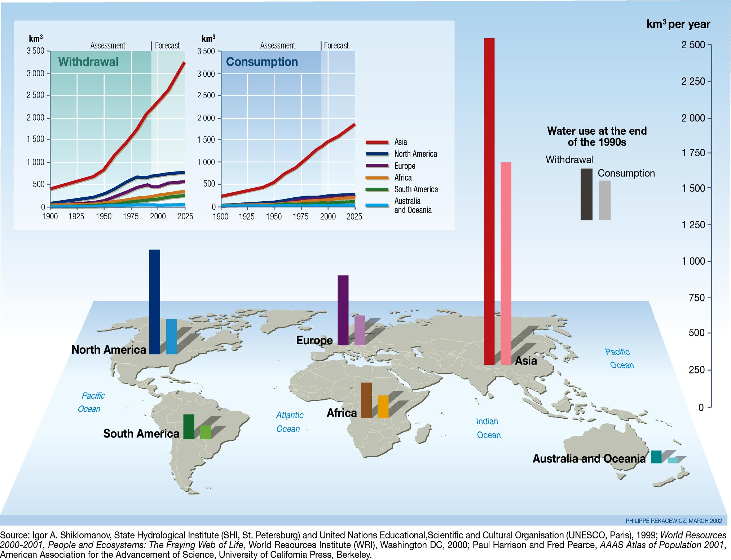

Slide 18
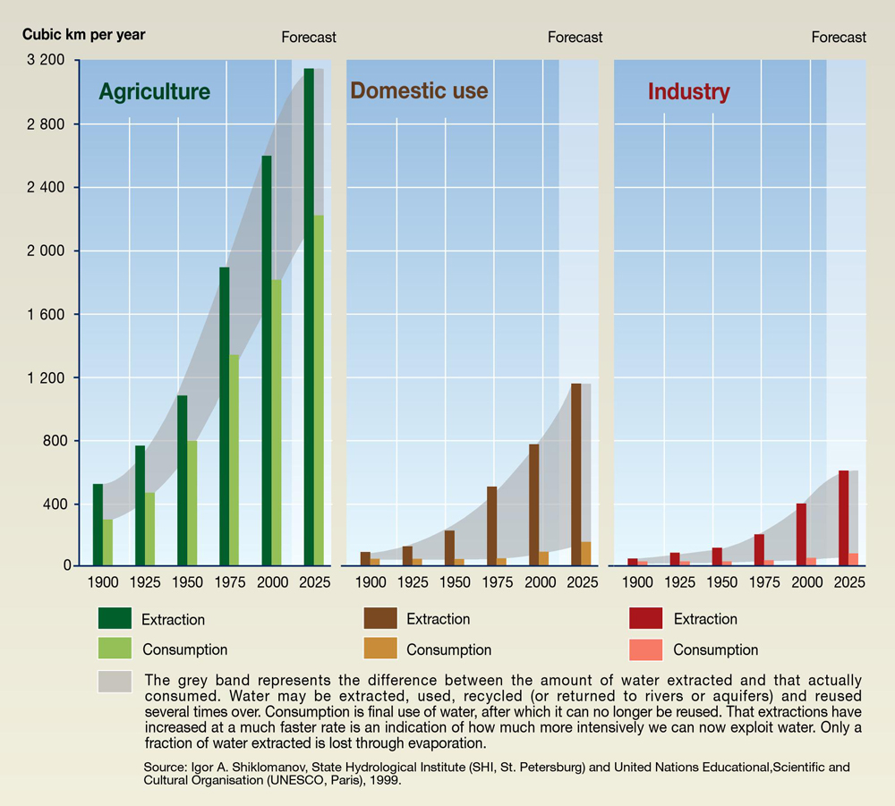

Slide 19
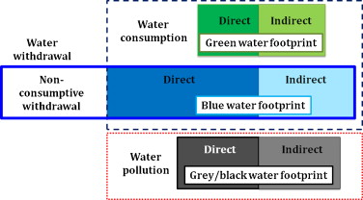
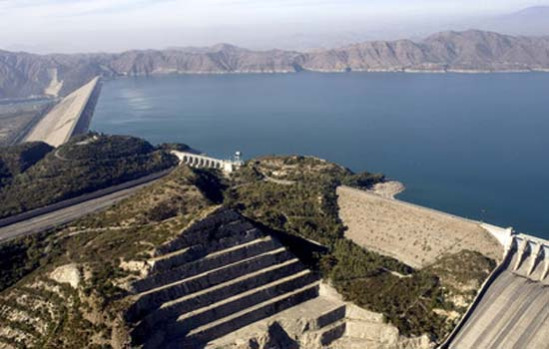
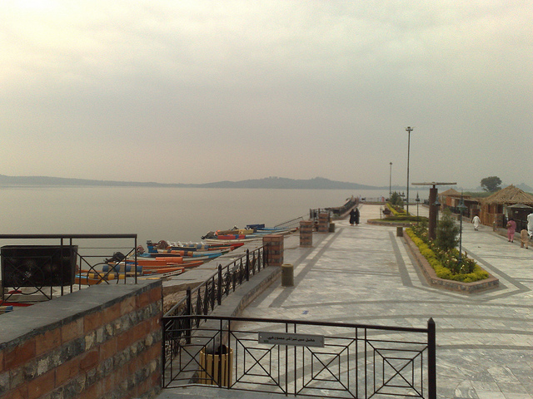
Non-Consumptive Water Use
Water withdrawn for use that is not consumed
e.g. water withdrawn for purposes such as hydropower generation
recreational activities
boating or fishing where the water is still available

Slide 20
Water Supply system
Water supply system is the complete layout of getting water from the source, treating it for removing impurities and then, distributing it to the public for various uses.
Good water supply system should satisfy the following requirements:
Water should be available in adequate quantity
Water to be supplied should be free from impurities and bacteria
It should be cheap
Water should be readily available to the consumers
It must be readily disposed off after it has served its purpose

Slide 21
Quality of water for public water supply
Absolutely pure water is never found in nature. Water served to the consumers must have the following qualities:-
It should be cool and colourless
It should be odourless and tasteless
It should be free from disease carrying bacteria
It should be fresh
It should not corrode pipes
It should be free from poisonous materials
It should be free from excessive amounts of organic matter and mineral.

Slide 22
Define the following terms:
Portable water
Wholesome water
Safe water
Pure water.

Slide 23
The 4 S’s: Some Common Terms
Water Shortage - absolute shortage where levels of available water do not meet certain defined minimum requirements.
Water Scarcity - a more relative concept describing the relationship between demand for water and its availability.
Water Stress - the symptomatic consequence of scarcity which may manifest itself as increasing conflict over sectoral usage, a decline in service levels, crop failure, food insecurity etc..
Water Security - a situation of reliable and secure access to water over time.

Slide 24
Water Scarcity
Water scarcity category and associated problems | Volume of water available (m³/person/year)
Beyond the “water barrier”: continual, wide-scale water supply problems, becoming catastrophic during droughts. | < 500
Chronic water scarcity: continual water supply problems, worse during annual dry seasons; frequent severe droughts. | 500 to 1,000
Water stressed: frequent seasonal water supply and quality problems, accentuated by occasional droughts. | 1,000 to 1,666
Moderate problems: occasional water supply and quality problems, with some adverse effects during severe droughts | 1666 to 10,000
Well-watered: very infrequent water supply and quality problems, except during extreme drought conditions. | > 10,000

Slide 25
Is there any question ?

Slide 26
WATER QUANTITY

Slide 27
Water quantity
Determination of total water quantity involves-
Water consumption rate (Per Capita Demand in litres per day per head)
Population to be served.
Quantity = Per capita demand x Population

Slide 28
Water Consumption Rate
Very difficult to assess the quantity of water demanded by the public, since there are many variable factors affecting water consumption.
There are various types of water demands in a city.
  Domestic water demand
  Industrial demand
  Institution and commercial demand
  Demand for public use
  Fire demand
  Loses and wastes
Notes:
During planning a water supply scheme, it is the duty of all the stakeholders affected by this process to examine the various types of water demand a city may have

Slide 29
Domestic water demand
water required in the houses for drinking, bathing, cooking, washing etc.
mainly depends upon the habits, social status, climatic conditions and customs of the people.
As per IS: 1172-1963, under normal conditions, the domestic consumption of water in India is about 135 litres/day/capita.

Slide 30
The details of the domestic consumption are
a) Drinking ------ 5 litres
b) Cooking ------ 5 litres
c) Bathing ------ 55 litres
d) Clothes washing ------20 litres
e) Utensils washing ------10 litres
f) House washing ------ 10 litres
--------------------------
135 litres/day/capita

Slide 31
Industrial demand
The water required in the industries mainly depends on the type of industries, which are existing in the city.
The water required by factories, paper mills, Cloth mills, Cotton mills, Breweries, Sugar refineries etc. comes under industrial use.
The quantity of water demand for industrial purpose is around 20 to 25% of the total demand of the city.

Slide 32
Institution and commercial demand
Universities, Institution, commercial buildings and commercial centres including office buildings, warehouses, stores, hotels, shopping centres, health centres, schools, temple, cinema houses, railway and bus stations etc comes under this category.

Slide 33
Demand for public use
Quantity of water required for public utility purposes such as for washing and sprinkling on roads, cleaning of sewers, watering of public parks, gardens, public fountains etc. comes under public demand.
To meet the water demand for public use, provision of 5% of the total consumption is made designing the water works for a city.

Slide 34
Fire demand
During the fire breakdown large quantity of water is required for throwing it over the fire to extinguish it, therefore provision is made in the water work to supply sufficient quantity of water or keep as reserve in the water mains for this purpose.
The quantity of water required for fire fighting is generally calculated by using different empirical formulae.

Slide 35
Fire Fighting Required Calculation
Total amount of water required : no. of fires X discharge X time of each fire
Amount of water required per person: amount of water/total population
Kuichling ‘s formula : Q= 3182√P
[ Q = amount of water required in
liters/minute]
[ P = population in thousands]
Freeman formula : Q= 1136[(P/10)+10 ]
Buston’s formula : Q= 5,663√P (Quantity of water required in liters per day)
(Kuichling formula, Freeman formula and buston formula give higher results. Because water for fire fighting is required for few times in a year.)
Q = 100√P (water is kiloliter per day)

Slide 36
Loses and wastes
Losses due to defective pipe joints, cracked and broken pipes, faulty valves and fittings.
Losses due to, continuous wastage of water.
Losses due to unauthorised and illegal connections.
While estimating the total quantity of water of a town; allowance of 15% of total quantity of water is made to compensate for losses, thefts and wastage of water.

Slide 37
Water Consumption for Various Purposes
 | Types of Consumption | Normal Range (lit/capita/day) | Average | %
1 | Domestic Consumption | 65-300 | 160 | 35
2 | Industrial and Commercial Demand | 45-450 | 135 | 30
3 | Public Uses including Fire Demand | 20-90 | 45 | 10
4 | Losses and Waste | 45-150 | 62 | 25

Slide 38
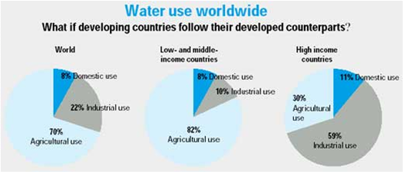

Slide 39
Factors affecting rate of demand
Size and type of community
Standard of living
Climatic conditions
Quality of water
Pressure in the supply
Notes:
Climatic conditions: Water requirements during summer are more than winter or during hot period more than during cold period.
Size of city: the demand of water per head will be more in big cities than that in small cities.
Habits of people: high class community uses more water due to their better standard of living than higher economic status. For poor people a single water tap may be sufficient for several families
Industries: more water will be required in highly industrialised city.
Cost of water: more costly is the water less will be rate of demand.
Quality of water: a water works system having a protected and good quality of water supply would always be more popular with consumers.
Pressures in the distribution system: these would be of great importance in the case of localities having a number of two or three storeyed buildings. Adequate pressure would mean an uninterrupted and constant supply of water.
Sewage facilities: Town having water carriage system will consume more water.
System of supply: The system of supply may be continuous or intermittent.
Method of charging: metering system or flat rate system.

Slide 40
Factors affecting rate of demand
Development of sewage facility
Metering of water
Cost of water
Industrial and commercial activities
System of water supply

Slide 41
Variation in rate of demand
In practices it has been seen that the per capita demand does not remain uniform throughout the year but it varies from season to season, even from hour to hour. Variation in rate of demand may be termed as:
Seasonal variation
Daily variations
Hourly variations

Slide 42
Seasonal variation: The demand peaks during summer. Firebreak outs are generally more in summer, increasing demand. So, there is seasonal variation .
Daily variation depends on the activity. People draw out more water on Sundays and Festival days, thus increasing demand on these days.

Slide 43
Hourly variations are very important as they have a wide range. During active household working hours i.e. from six to ten in the morning and four to eight in the evening, the bulk of the daily requirement is taken. During other hours the requirement is negligible.
Moreover, if a fire breaks out, a huge quantity of water is required to be supplied during short duration, necessitating the need for a maximum rate of hourly supply.

Slide 44
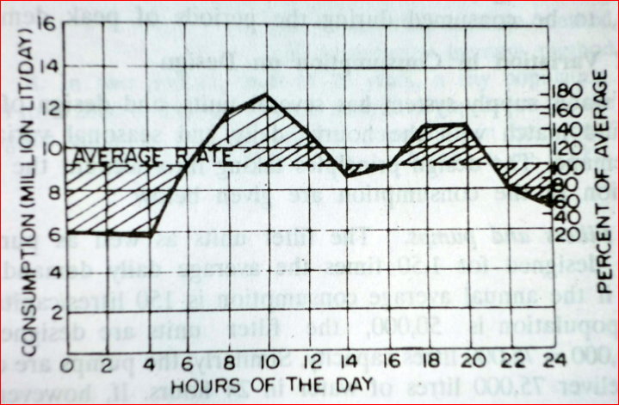
Sketch graph of daily water demand variation

Slide 45
So, an adequate quantity of water must be available to meet the peak demand.
To meet all the fluctuations, the supply pipes, service reservoirs and distribution pipes must be properly proportioned.
The water is supplied by pumping directly and the pumps and distribution system must be designed to meet the peak demand.

Slide 46
The effect of monthly variation influences the design of storage reservoirs and the hourly variations influences the design of pumps and service reservoirs.
As the population decreases, the fluctuation rate increases.

Slide 47

Per capita demand
If ‘Q’ is the total quantity of water required by various purposes by a town per year and ‘P’ is population of town, then per capita demand per day ‘p’ will be

Slide 48
Per capita demand of the town depends on various factors like standard of living, no. and type of commercial places in a town etc.
For an average Indian town, the requirement of water in various uses is as under-
Domestic purpose -------- 135 litres/c/d
Industrial use -------- 40 litres/c/d
Public use -------- 25 litres/c/d
Fire Demand -------- 15 litres/c/d
Losses, Wastage and thefts -------- 55 litres/c/d
--------------------------
Total : 270 litres/capita/day

Slide 49
Population to be served
After deciding the quantity of water required by an individual, the next step in the design of water supply scheme will be to find the total quantity required by a community.
Knowing the present population from the most recent census, it is possible to determine the present demand, but for the design what is required; is the demand in future.

Slide 50
Population to be served
The various methods adopted for estimating future populations .
The particular method to be adopted for a particular case or for a particular city depends largely on the factors discussed in the methods, and the selection is left to the discretion and intelligence of the designer.
The design period taken is generally 20 to 30 years.

Slide 51
Methods of Population forecasting
The following are the methods used for population forecast:
Arithmetical Increase Method
Geometrical Increase Method
Incremental Increase Method
Changing rate of increase
Graphical method
Comparative method

Slide 52
Forecasting cont......
Arithmetical Increase Method: In this method, the increase in population is assumed to be constant and an average increase of the last 4 to 5 decades is calculated and added in the present population to determine population of the next future decade. The population can be found out at the end of n year or decades. This method gives too low an estimate.
P_{n} = P+n x i
where P = Present population
  i = Yearly or per decade increase of population

Slide 53
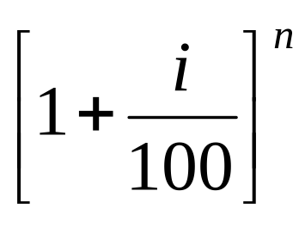
Forecasting cont......
Geometrical Increase Method: In this method the average % age of growth of last few decades is determined, the forecasting is done on the basis that percentage increase per decade will be the same. Thus the population at the end of n years or decades is given as:
P_{n} =P
Where i = Yearly or per decade percentage rate of increase.

Slide 54
Forecasting cont......
Incremental Increase Method: This method is an improvement of the above two methods. The average increase in the population is calculated by the arithmetical method and to this is added the average of the net incremental increase once for each future decade.
Changing Rate of increase: It is similar to the
Geometrical method except that a changing rate rather than a constant rate of increase is assumed.
The changing rate for large and grown up cities is usually considered to be a decreasing rate. This method gives quite rational results.

Slide 55
Forecasting cont......
Graphical Method: In this method the population of last few decades (as per census) is correctly plotted to the scale on the graph-paper. The curve is smoothly extended to find the future population. Sometimes population trend lines are plotted and similar expected population trend lines are drawn.
Comparative method: Cities having similar characteristics to the city whose population is to be estimated are selected. Then on the basis of those cities, the population of the required city is forecasted. Graph may be plotted if necessary.

Slide 56
Assignment
Estimate the population in the year 2000 from the following census data for 'Wahapahapa' Town by using Arithmetical Increase method, Geometrical Increase method, Incremental Increase method and decrease method. If the water demand in 2000 is 4.05x10⁸ liter, what will be the per capita water demand, considering the population projection by the use of arithmetic increase method.
Year | 1950 | 1960 | 1970 | 1980
Population in Thousands | 10 | 14 | 19 | 25

Slide 57
References:
ALAN C. TWORT, DON D. RATNAYAKA & MALCOLM J. BRANDT. (2000) Water Supply.5th ed. London: Eliane Wigzell, pp 1-2.
A.K. UPADHYAY. (2009) Water Supply and Waste Water Engineering. India: Sanjeev Kataria, pp 1-17.

